Slide 1
Sprint 7
Team 9

Slide 2
Summary
Partial new game implementation - Jeopardy!
Carousel Component Implementation
Minor redesign changes and bug fixes

Slide 3
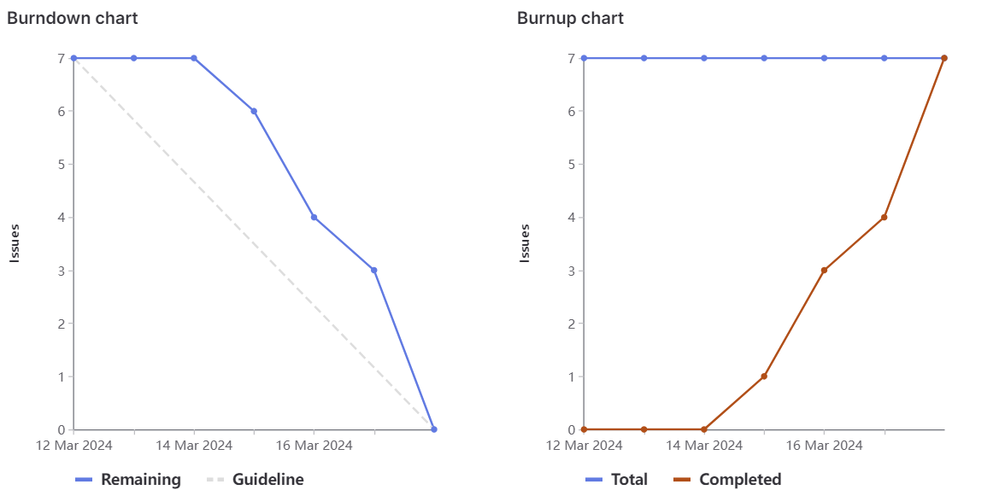
Burn Down

Slide 4
Cavaari Taylor (Team Lead)
Carousel Implementation
Game card Implementation
Main Page Slight redesign & Bug fixes
Weights: 12

Slide 5
Egor
Jeopardy! Parser and Generator Functions
Jeopardy! API + usage Example
Front-end help
Weight: 12

Slide 6
Tehreem
Back end (creating game logic/front end function calls)
Researching which dataset to use and parsing the tsv file
Bug fixes & Visual Improvements
Weight: 12

Slide 7
Karina
Designed backend for Jeopardy game (+Game research)
Implemented backend for Jeopardy game with connections ready for front end
Visual improvements and bug fixes
Total Weights: 12

Slide 8
Muhammed
Worked on front end for the main page additions
Helped with front end for Jeopardy game
Weights : 12

Slide 9
Eric
Helped with backend
Bug fixes and visual improvements
Had a very very busy week
Total weights: 10

Slide 10
Kalindu
Jeopardy! Parser and Generator Functions
Front-end implementation
Weight: 12

Slide 11
Reflection
What went well:
Sprint Planning and general Implementation
What didn't go well:
Communication between sub-teams
What we will do better:
Communicate and be more transparent on task completion

